Slide 1
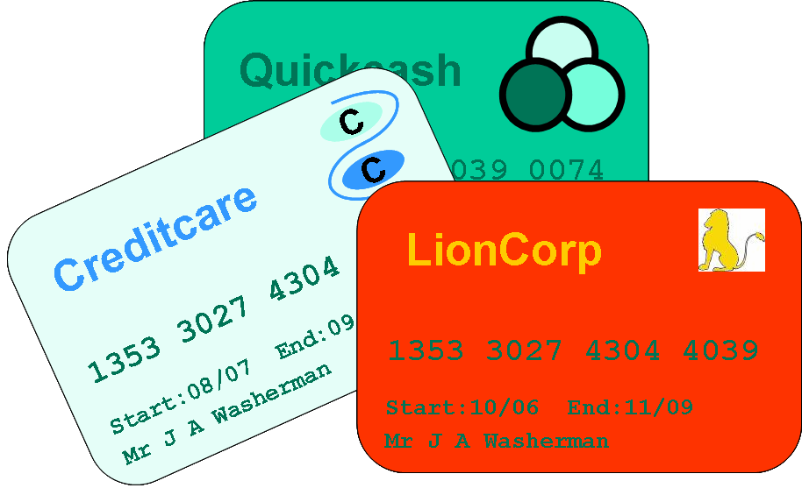
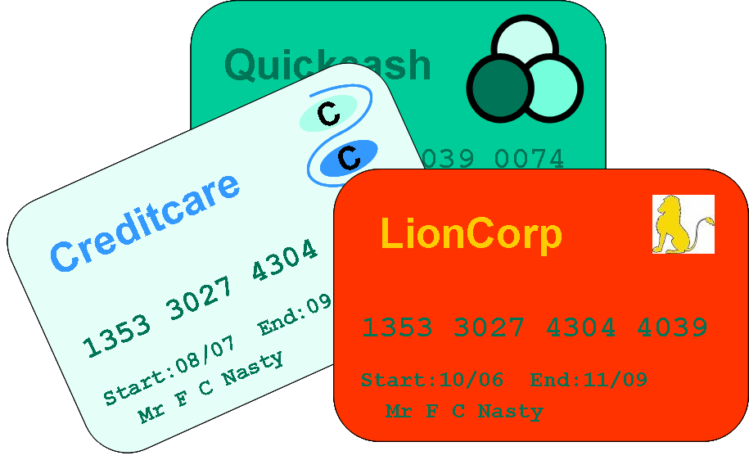
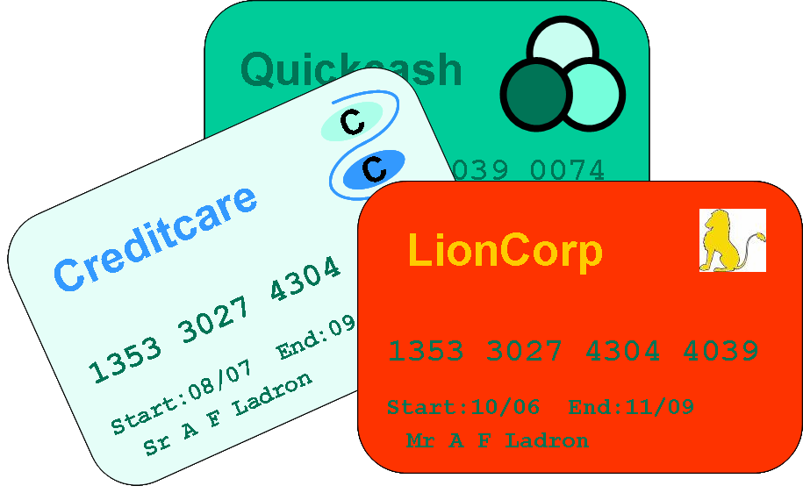
Credit Cards (1)
Mr X
Alias A
Alias B
Mr Y
Notes:
Use of credit cards for money laundering – example
The example derives from a real case. A single individual (Mr X) fraudulently obtains a number of credit cards from different institutions, using a variety of different names and aliases. In some cases he holds several different cards with the same institution. Using the same method of aliases he establishes further credit card accounts overseas.
He then uses the credit cards to make some fairly ordinary purchases (restaurant meals, etc) and some very expensive purchases (e.g., cars, paintings, expensive jewellery, etc). He uses criminal funds to pay off the credit card debts incurred. Some of the payments are made by cheque from accounts in the name of the given card holder. Some are made by an apparently unconnected third party, Mr Y.
The valuable assets purchased in this way are subsequently sold on to other uninvolved parties and the proceeds of the sales are invested elsewhere.
The ordinary card purchases are simply used as a guise to give the impression of ‘normal’ daily usage of the cards in a normal daily routine.

Slide 2
Credit Cards (2)
Key facts
Use in money laundering: in layering and integration activities
Link with other financial crime: card theft, credit card fraud
Global prevalence: increased global reliance on ‘plastic money’
Money launderers’ perspective
Immediate access to funds at the touch of a button from anywhere in the world
‘Remoteness’ of many transactions enhances opportunities for concealment
Easy, swift conversion of criminal cash into other assets
Notes:
Key facts
Credit cards are widely used in most of the world’s economies and generate billions of transactions worldwide each year. No-one really knows the extent to which they are used for money laundering purposes, but there is a consensus view that they are not likely to be used at the placement stage (where criminal cash is first introduced into the financial system), and are much more likely to have a role in layering and integration activities.
Money laundering using credit cards will also tend to go hand-in-hand with other credit-card related crimes, e.g., theft (where an innocent third party’s identity is taken from a stolen credit card and used to establish new card accounts) and credit card fraud (where such falsely obtained cards are used to purchase goods fraudulently).
Credit cards are in such prevalence and are so widely used that all financial institutions across the world are potentially affected by credit card crimes.
Money launderers’ perspective
One of the great benefits of credit cards for legitimate card holders is the ability, via ATM machines, to be able to access money from just about any financial institution, anywhere in the world. This benefit is clearly also advantageous to money launderers, since it gives them a means by which they can, very quickly and simply, move quite large amounts of money across international borders, without ever having to come face-to-face with a member of staff from the institution in question.
The remoteness of many credit card transactions (transactions over the ‘phone, over the internet, etc) also assists money launderers in concealing their identities.
Finally, credit cards can be used to buy just about anything, with the credit card account being paid off regularly in cash or by electronic transfer. This helps money launderers in converting their criminal cash into legitimate and saleable assets that can be sold on as part of the layering process.

Slide 3
Credit Cards (3)
Possible ‘red flags’
Sudden change in transaction patterns on a credit card account
Transactions that do not fit with the known business of the named credit card holder
Multiple credit cards in different names linked to a single residential address and/or third party settlor
Third party settlement of credit card accounts
Unusually large cash settlement of credit card accounts
Unusually large and frequent cash withdrawals from off-shore credit card accounts
Notes:
Transactions that might give cause for concern include the following:
A sudden change in the transaction patterns on a credit card account, or transactions that do not fit with the known business of the named card holder (this may indicate that the card has been stolen, or that the card account has been accessed and is being used by an unauthorised third party)
Multiple cards in different names linked to a single residential address and/or third party settlor (this may indicate that multiple identities and different aliases are being used by a single individual)
Third party settlement of credit card accounts (this might indicate the use of aliases as described above; or it may indicate that the card holder is in fact using the card to make purchases/launder money on behalf of an unknown third party)
Unusually large cash settlement of credit card accounts (people do sometimes settle their accounts in cash, but rarely for large amounts; very large cash settlements might however be used as a means to start clearing criminal cash through the financial system)
Unusually large and frequent cash withdrawals from off-shore credit card accounts (this use of credit cards may indicate an attempt to ‘layer’ criminal money by moving it between jurisdictions).
N.B. The terrorists involved in the 9/11 attacks used credit cards via the ATM system to withdraw money from offshore credit card accounts. Funds were paid into these accounts by third parties overseas. The terrorists drew on the funds to pay for their day-to-day living expenses, and the costs incurred in setting up their terror attacks.

